Slide 1

Application Quizer: Empowering Instructors and Students

Slide 2
made by:
Ahmed Sobhi
zeiad Mohamed
Abdallah Hassan
Abdelbaset Mohamed
Omar Sayed
Ahmed Moataz

Slide 3
Leveraging Flutter and Clean Architecture for Exceptional Design
Flutter Prowess
Clean Architecture
Exceptional UX
Utilizing the robust Flutter framework, the app boasts a visually stunning and responsive user interface that seamlessly adapts to various devices.
The app's codebase adheres to the principles of Clean Architecture, ensuring maintainability, testability, and scalability.
The clean and intuitive design, combined with Flutter's performance, delivers an exceptional user experience for both instructors and students.

Slide 4
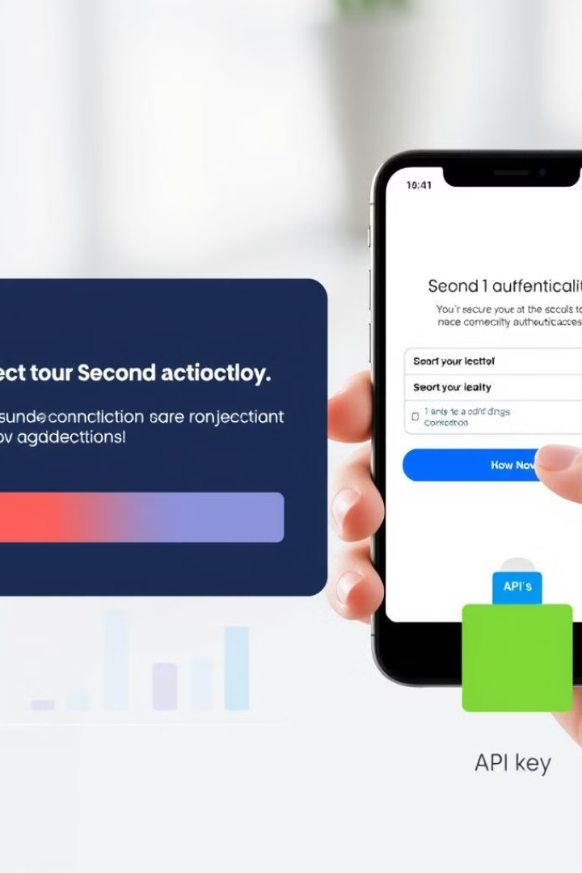
Seamless Authentication: Custom API Integration
Custom API Integration
Flexibility
The app features a custom API integration for seamless authentication, ensuring a secure and streamlined login experience.
The authentication system is designed to be flexible, allowing for future integration with third-party providers like Google and Facebook.
User Privacy
Smooth Onboarding
User privacy is a top priority, with robust security measures in place to protect sensitive data and user information.
The authentication process is optimized for a smooth and efficient onboarding experience, ensuring users can quickly get started with the app.

Slide 5
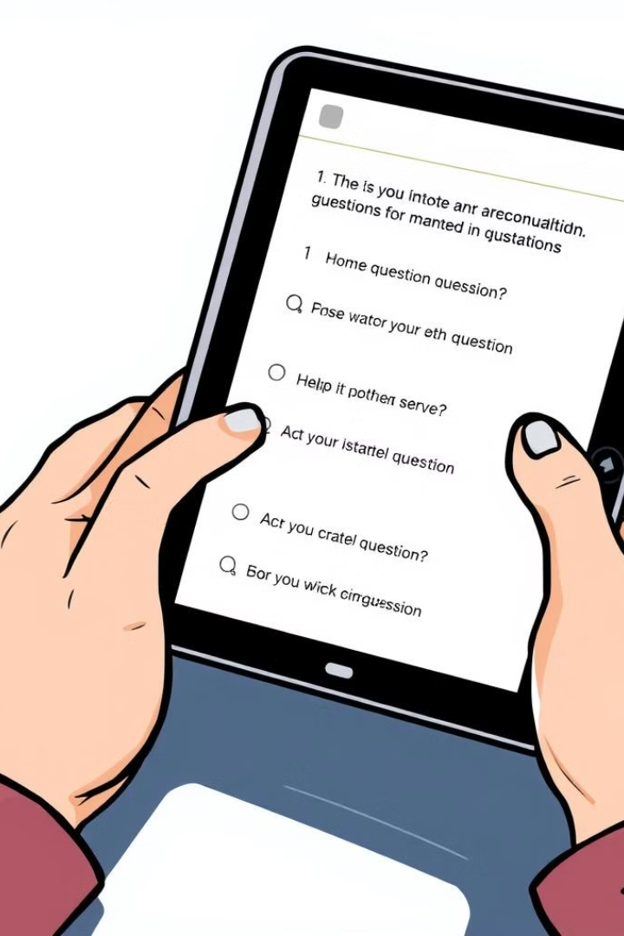




Question Creation: Intuitive Interface for Instructors
Question Management
Question Categorization
Instructors can easily create, edit, and organize a wide range of questions within the app's intuitive interface.
Questions can be categorized by topic, difficulty, or any other relevant criteria, providing a structured learning experience.
Question Preview
Publish and Share
Instructors can preview questions before publishing them, ensuring the content is accurate and engaging.
Once satisfied, instructors can easily publish and share the questions with their students.

Slide 6

Student Experience: Solving Questions, Scoring Points
1
Question Solving
Students can access a wide range of questions, organized by topic and difficulty, and test their knowledge with engaging quiz sessions.
2
Scoring System
Correct answers earn 5 points, while incorrect answers result in a 2-point deduction, adding an exciting element of competition.
3
Progress Tracking
Students can monitor their progress and achievements, driving continuous engagement and a sense of accomplishment.

Slide 7

Local Push Notifications: Keeping Users Engaged
1
Timely Reminders
2
Customizable Settings
3
Consistent Engagement
Local push notifications alert users to upcoming quizzes, new content, and other important updates, ensuring they stay engaged with the app.
Users can customize their notification preferences, allowing them to tailor the app's engagement to their individual needs and preferences.
The consistent delivery of relevant notifications fosters a strong connection between the app and its users, driving continuous usage and learning.

Slide 8
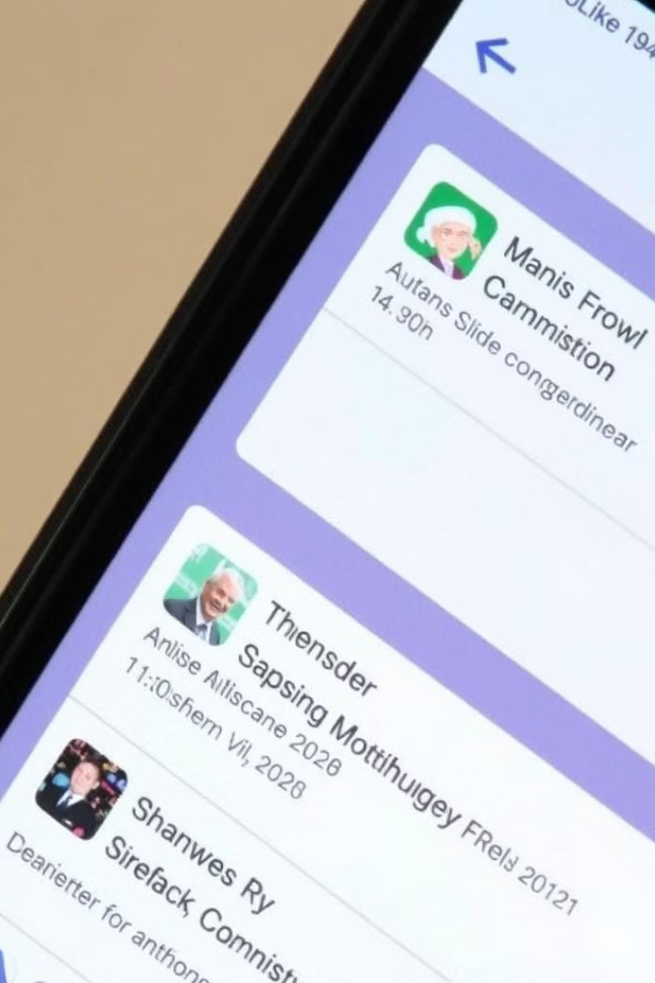



Scheduled Notifications: Driving Consistent Engagement
Scheduled Quizzes
The app allows instructors to schedule quizzes and assessments, which are then communicated to students through timely notifications.
Reminders and Alerts
Users receive scheduled reminders and alerts for upcoming deadlines, ensuring they stay on top of their learning goals.
Consistent Engagement
These scheduled notifications help maintain a consistent engagement, encouraging students to regularly interact with the app and stay motivated.

Slide 9

Conclusion: The Future of Effective Learning Experiences
Application Quizer is poised to transform the way instructors and students approach learning. By seamlessly integrating cutting-edge technology, intuitive interfaces, and engaging features, the app delivers an exceptional educational experience that empowers users to achieve their goals.

Slide 10

Thank You

